Slide 1

Axiomatic Attribution for Deep Networks
12 Feb 2020
Presenter: Sanchit Sinha
https://qdata.github.io/deep2Read/

Slide 2
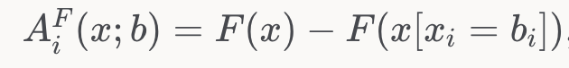
Background - Attribution
Attribution:
Let F(x) represent output of a DNN on input x (x1,x2,...xn) [n-dimensional]
Attribution wrt a baseline A (x,x_) is a vector of same dimension of the input [n-dimensional]
Intuitively, the weight(importance) each feature has in making the prediction

Slide 3
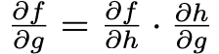
Background - Axioms
Sensitivity(a): If for every input and baseline that differ in one feature and have different predictions, then the differing feature should be given a non-zero attribution score.
Sensitivity(b): If the function implemented by the DNN does not depend (mathematically) on some variable, then the attribution to that variable is always zero.
Implementation Invariance: the attributions are always identical for two functionally equivalent networks. It should not depend on the implementation of the network
Linearity: Linear composition of two deep networks modeled by the functions f1 and f2 to form a third network that models the function a×f1+b×f2, then the attributions for a × f1 + b × f2 to be the weighted sum of the attributions for f1 and f2 with weights a and b respectively.

Slide 4
Background - Previous Methods weakness
Violating Sensitivity: “Gradients*inputs (element-wise)” - standard debugging practice (at time of writing the paper) violate sensitivity.
Why?- Assume F(x) = 1 − ReLU(1−x). Taking baseline, x=0. Gradient of F(x) for x>1 becomes 0. So lets say at x= 2, even though function is changing from 0 to 1, the attribution score is 0.
Intuitively, the prediction function may flatten at the input and thus have zero gradient despite the function value at the input being different from that at the baseline.
DeConvNets and Guided backpropagation also violate because these methods back-propogate through a ReLU node only if the ReLU is turned on at the input
Violating Implementation Invariance: DeepLift and LRP violate this. The outputs of the methods should not depend on the model if the inputs and outputs are same.
The attributions are sensitive to unimportant aspects of the models. For instance, if the network architecture has more degrees of freedom than needed to represent a function then there may be two sets of values for the network parameters that lead to the same function

Slide 5
Motivation
Evaluation of attribution methods is challenging.
It is hard to explain errors that are due to misbehavior of the model or the misbehavior of the attribution method.
Hence, axiomatic approach is proposed: any method which satisfies the axioms should be desirable (at least on paper)
Designing a method which satisfies all the axioms proposed. They call it Integrated Gradients
Showing that previous methods don’t satisfy the axioms proposed and hence lack generalization and performance
Notes:
The motivation of this project

Slide 6
Related Work
Layer Wise Relevance Propagation - Binder, Alexander, Montavon, Gregoire, Bach, Sebastian, ´ Muller, Klaus-Robert, and Samek, Wojciech. Layer- ¨ wise relevance propagation for neural networks with local renormalization layers. CoRR, 2016
DeepLift - Shrikumar, Avanti, Greenside, Peyton, and Kundaje, Anshul. Learning important features through propagating activation differences. CoRR, abs/1704.02685, 2017. URL http://arxiv.org/abs/1704.02685.
Deconvolutions - Zeiler, Matthew D. and Fergus, Rob. Visualizing and understanding convolutional networks. In ECCV, pp. 818– 833, 2014
Guided Backprop - Springenberg, Jost Tobias, Dosovitskiy, Alexey, Brox, Thomas, and Riedmiller, Martin A. Striving for simplicity: The all convolutional net. CoRR, 2014.

Slide 7
Claim / Target Task
Present 2 axioms which every attribution method should satisfy to be considered good enough
Present a novel method which satisfies all axioms called Integrated Gradients
Combine the best of both worlds - Implementation Invariance of Gradients along with the Sensitivity of techniques like LRP
or DeepLift.
Demonstrate results on both vision and textual problems
Notes:
Here, we make the claim of this project.

Slide 8
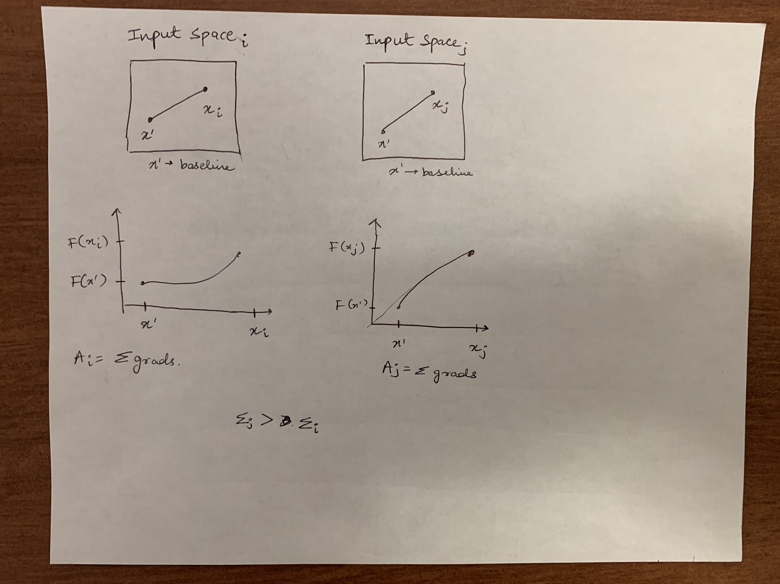
An Intuitive Figure Showing WHY Claim
Notes:
Here, we make the claim of this project.

Slide 9
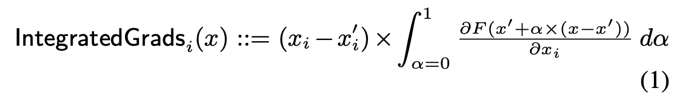
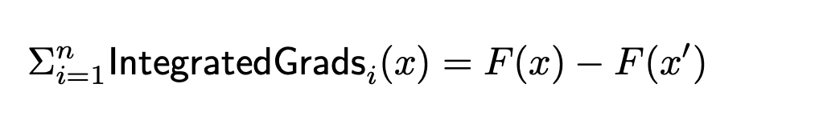
Proposed Solution
Integrated Gradients: Formulated for every dimension i as
Basically, it says that we should sum up all gradients along the straight line from baseline to input. Once we do this, we get:
Why Straight Line? - Maximum gradients will be accumulated by moving on a straight line as opposed to a curvy way
Notes:
Here is our proposed solution.

Slide 10
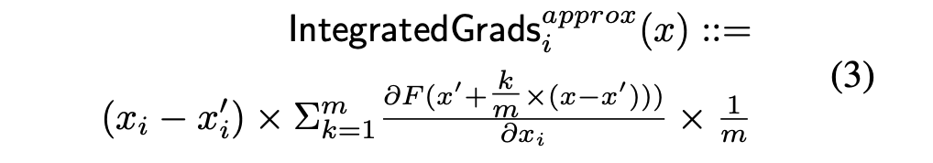
Implementation
The integral can be well approximated using summation over many steps. Practical usage can use about 20-300 steps
Baseline selection for images: Black images (0 valued pixel values)
Baseline for text: (0 valued vectors)
Once the gradients are found, they are multiplied with the image to get the final explainable maps
Notes:
In the rest of this presentation, I’m going to talk about following contents:

Slide 11
Data Summary
Imagenet and GoogleNet
Diabetic Retinopathy Prediction - (Gulshan et al., 2016)
WikiTableQuestions dataset - (Kim, 2014)
Chemistry W2n2 dataset
Notes:
In the rest of this presentation, I’m going to talk about following contents:

Slide 12
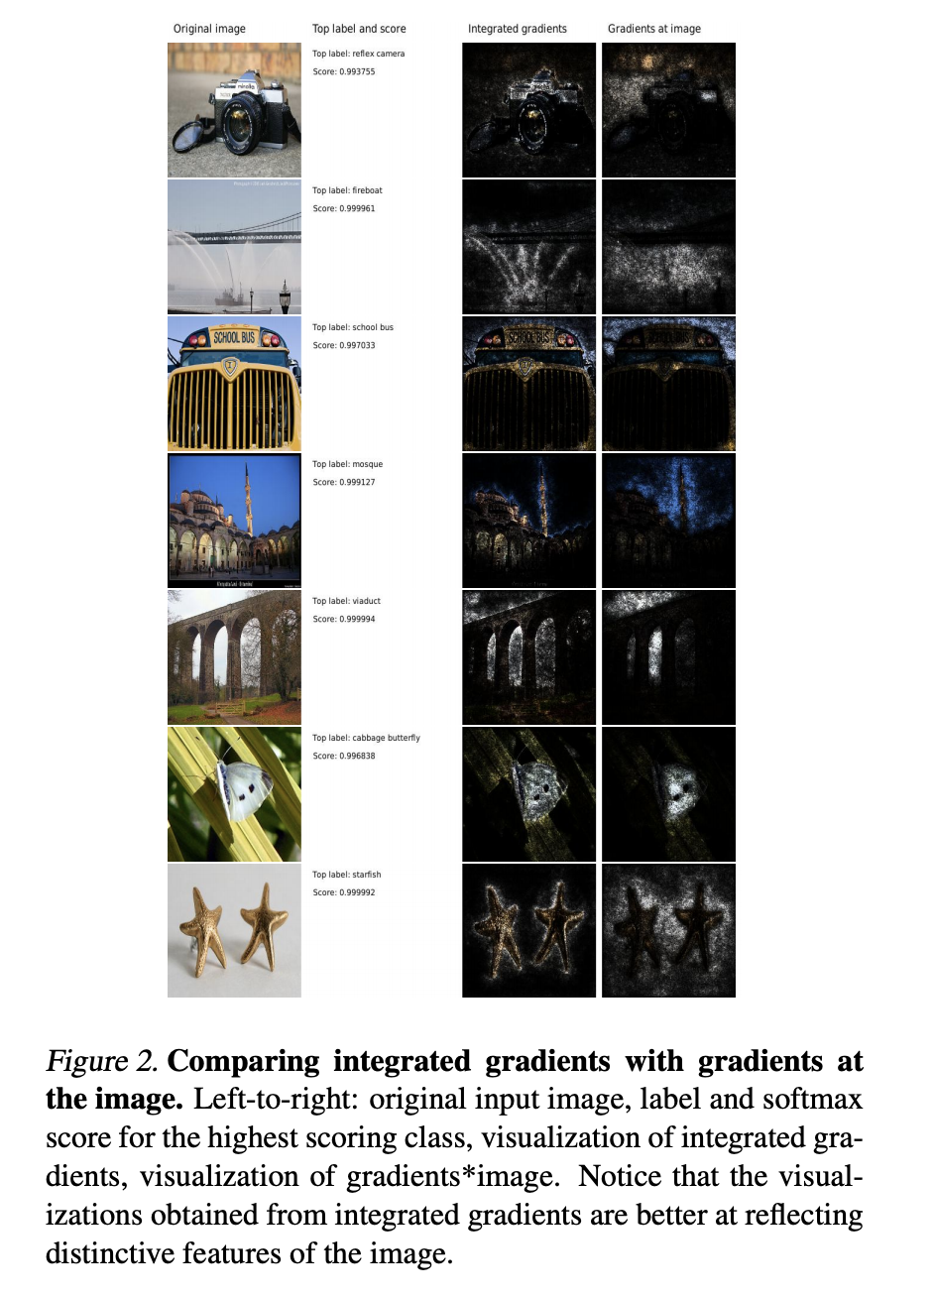
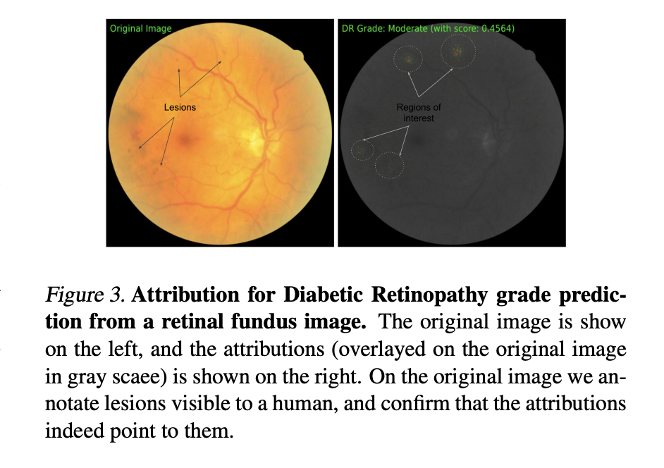
Experimental Results - Images
Notes:
In the rest of this presentation, I’m going to talk about following contents:

Slide 13
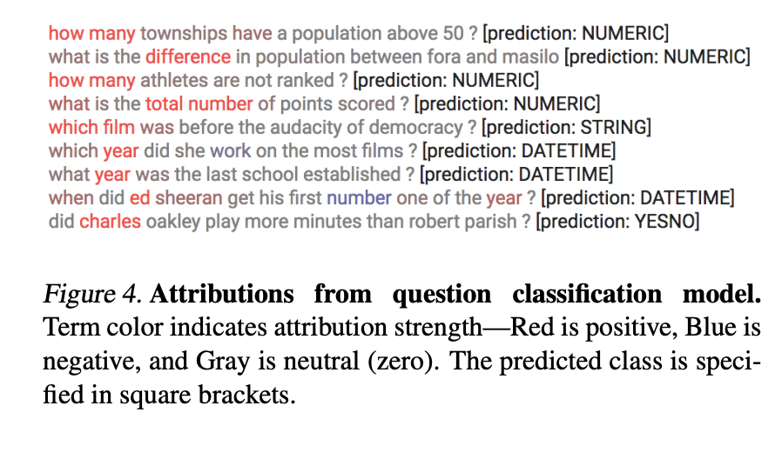
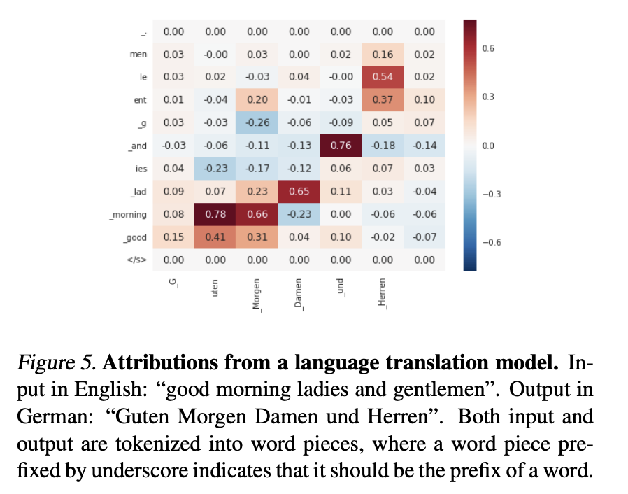
Experimental Results - Text

Slide 14
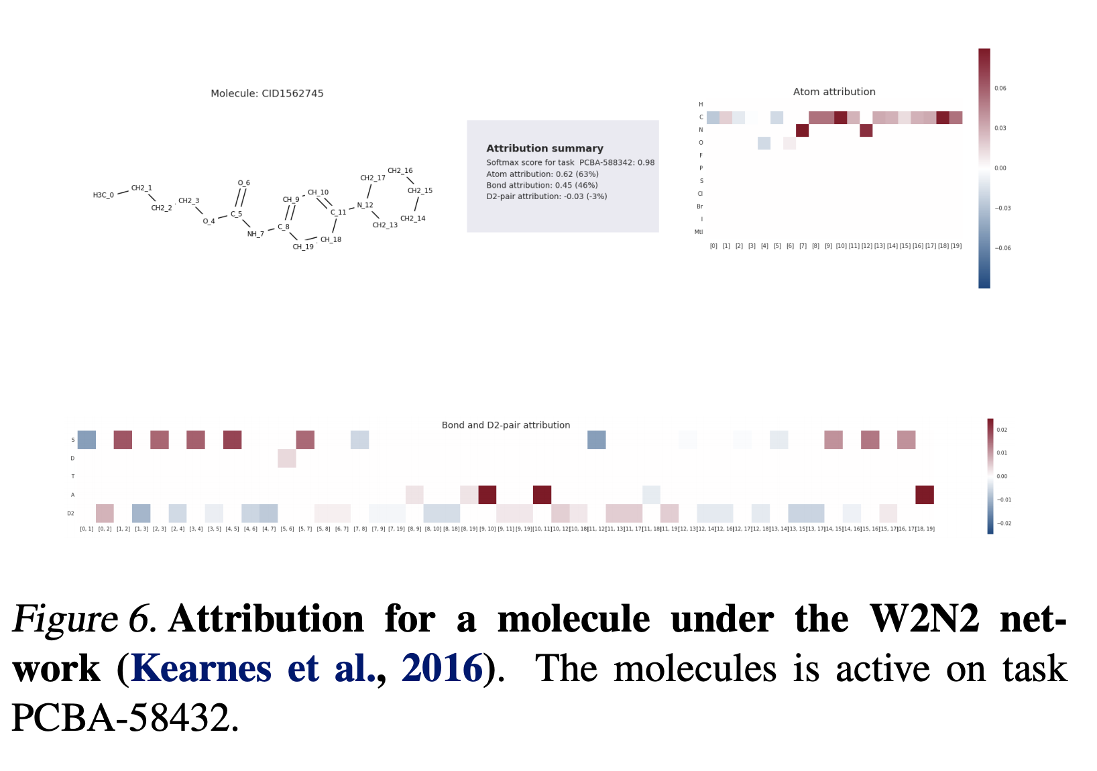
Experimental Results - Chemistry

Slide 15
Conclusion/ Future Work
Introduced Integrated gradients:
Maintains Sensitivity (Completeness)
Implementation Invariant
Has Linearity
Proposed axioms which are universal and baseline for further methods

Slide 16
References
Layer Wise Relevance Propagation - Binder, Alexander, Montavon, Gregoire, Bach, Sebastian, ´ Muller, Klaus-Robert, and Samek, Wojciech. Layer- ¨ wise relevance propagation for neural networks with local renormalization layers. CoRR, 2016
DeepLift - Shrikumar, Avanti, Greenside, Peyton, and Kundaje, Anshul. Learning important features through propagating activation differences. CoRR, abs/1704.02685, 2017. URL http://arxiv.org/abs/1704.02685.
Deconvolutions - Zeiler, Matthew D. and Fergus, Rob. Visualizing and understanding convolutional networks. In ECCV, pp. 818– 833, 2014
Guided Backprop - Springenberg, Jost Tobias, Dosovitskiy, Alexey, Brox, Thomas, and Riedmiller, Martin A. Striving for simplicity: The all convolutional net. CoRR, 2014.

Slide 17
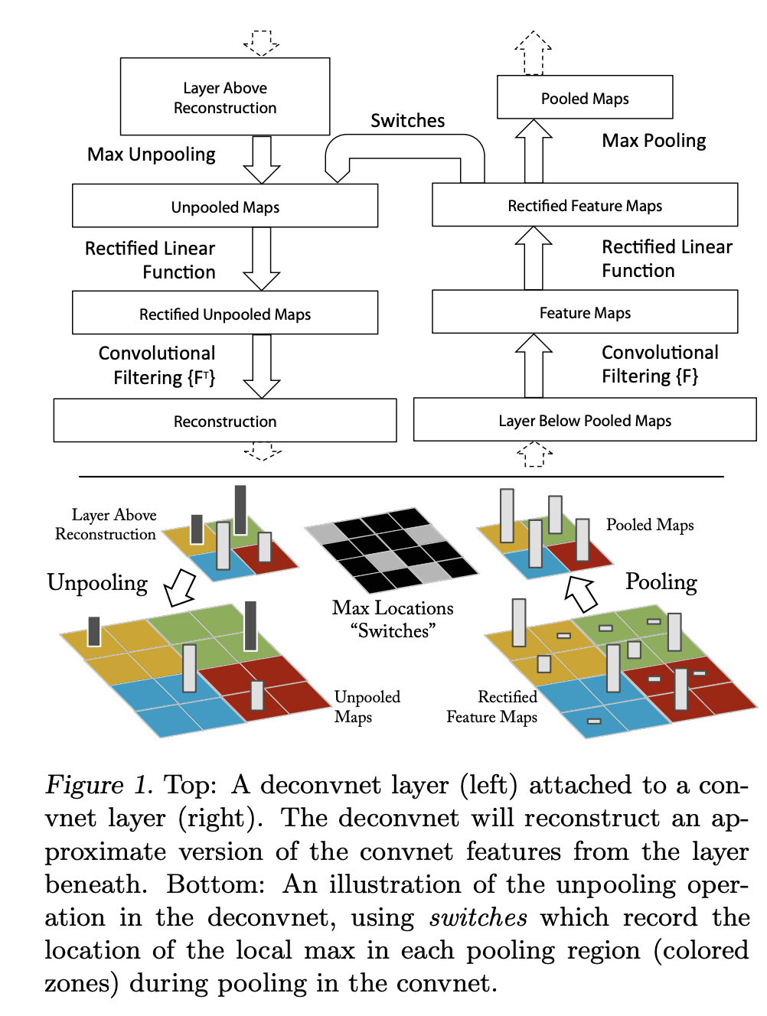

Slide 18
Ideas
Adversarial Training => Better Saliency maps
Can we use Saliency maps => adversarial robustness
Quantification metrics for saliency maps
Modifying GradCAM for ConvGNNs
Computing Saliency maps for GANs - Making GANs explainable

